Slide 1

Welcome meeting – Year 6
2025 - 2026

Slide 2
Meeting the Year 6 team
Mr Mackie – Phase Leader
Mr Mackie
Mozart class
Ms Khan and Mrs Quereshi
Simone class
Mrs Bacon
Caruso class

Slide 3
Chain of communication
Class Teacher → Phase Leader→ Senior Leadership

Slide 4

Attendance / Lateness
Attendance is key to making good progress, so it’s really important to ensure your child attends everyday.
It is important that your child is at school on time as core subjects take place in the mornings.
New timings to school day : 8.50am -3.30pm
Gates close at 9am

Slide 5

Meal selection
If your child is school dinners, please pre-order lunches at home.
Even if they are school dinners, please make sure that they bring a labelled water bottle with them.

Slide 6
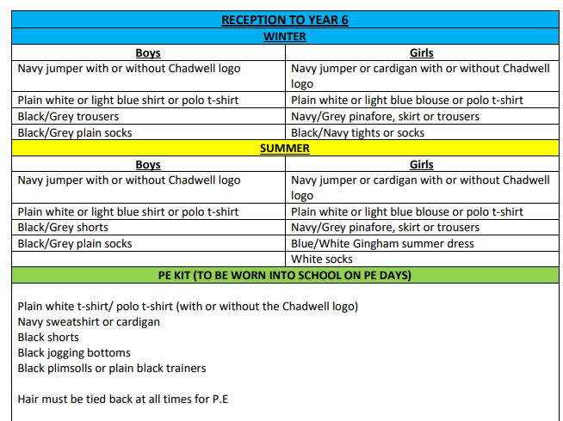
Uniform
This document can be found on our school website under the 'parents' tab.

Slide 7
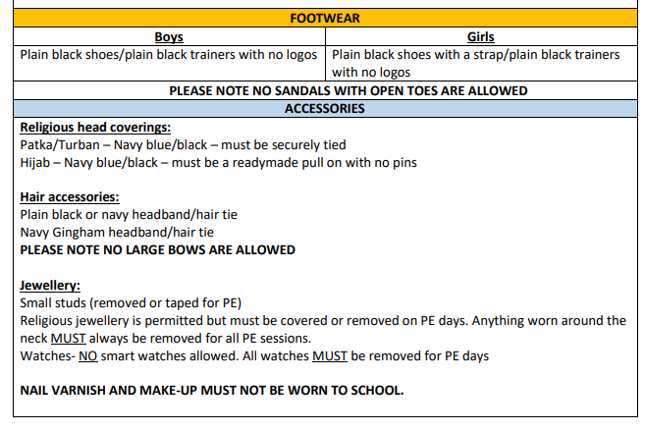
Uniform
This document can be found on our school website under the 'parents' tab.

Slide 8
P.E. Uniform
Black/Navy shorts
Plain white or blue T-shirt
Black plimsolls or trainers
Black or Navy track suit or jogging bottoms for outdoor games in cold weather
Pupils can also wear their school uniform jumper on top during colder weather

Slide 9
The new Curriculum Overview will soon be available on the school's website....
A Quick-view of Year Six Topics. -
Autumn Term:
Imperial War Museum – 14th, 16th and 17th October
Books – King Kong and The Place for Me – Stories about the Windrush Generation
Spring Term:
Books – The Selfish Giant and Island – A story of the Galapagos Islands
A focus on SATs revision
Natural History Museum
Summer Term:
Books - Manfish – a story of Jacques Cousteau and Poetry by William Shakespeare
Field work Enquiry in our local environment and a trip to the Gurdwara

Slide 10






Writing
English lessons are based on a core text.
We use the teaching scheme ‘Pathways to Write.’
Writing is taught both through discrete English lessons and through other areas of the curriculum.
The texts we will be focusing on this year are: King Kong, The Place for Me – Stories about the Windrush Generation, The Selfish Giant, Island – A story of the Galapagos Islands, Manfish – a story of Jacques Cousteau and Poetry by William Shakespeare

Slide 11
Reading
We teach reading through:
Guided Reading to teach specific types of reading skills
Reading and the teaching of books in English lessons
Use of the Oxford Reading Tree scheme to teach Reading (de-coding, segmenting, blending and vocabulary) as well as reading skills (prediction, comprehension, features of books)
Free choice of books from class reading area
Free choice of books from school library
You could:
Visit your local library
Have story time before bed
Read regularly with your child

Slide 12
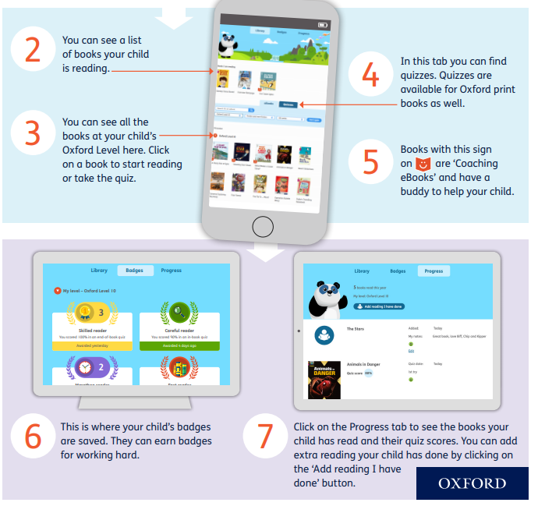

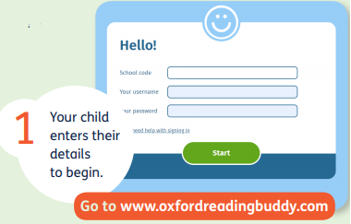
Reading – Oxford Reading Buddy
n1tts
Every child has a log on card.

Slide 13

Reading books
Children will change their books once they have finished reading it.
Reading records are no longer being used.
Please read with your child as often as possible.
It is essential to talk through the book with your child and ask them questions to monitor their understanding and deepen their comprehension skills.

Slide 14


Maths – Maths Mastery
Mathematics Mastery by Ark Curriculum Plus is a carefully sequenced programme designed to help all pupils develop a deep, secure, and long-lasting understanding of mathematics. Built on the principles of mastery, the programme focuses on three key dimensions of learning: conceptual understanding, mathematical thinking, and language and communication. These principles are embedded throughout Key Stages 1 and 2 to ensure consistent progression and to support all learners in developing the knowledge and confidence they need to succeed in maths.
In Key Stage 2, the curriculum builds systematically on the foundations laid in earlier years, deepening pupils’ understanding of number, calculation, fractions, geometry, measurement, and statistics. Lessons follow a clear structure using the Concrete–Pictorial–Abstract (CPA) approach, allowing pupils to explore concepts using manipulatives and visual representations before moving to abstract methods. Regular opportunities for reasoning and problem-solving strengthen fluency while encouraging pupils to make connections and apply their knowledge in a range of contexts.
This approach ensures that pupils leave Key Stage 2 with a strong foundation for further mathematical study in secondary school. By focusing on depth rather than acceleration, the programme closes gaps in understanding and promotes confidence, resilience, and flexibility in thinking. Pupils develop the ability to explain their reasoning, justify their methods, and solve increasingly complex problems—skills that are essential not just for maths, but for learning across the curriculum.

Slide 15

Homework- Doodle for Learning
Homework for Years 3, 4, 5 and 6 will now be assigned on Doodle for learning. Doodle for learning is an online educational program for children, focusing on Maths, English, Timetables and Spelling.
Your child will complete a baseline assessment in class as he/she must needs to complete this independently, so that the app can get a clear understanding of their strengths and weaknesses and adapt to the individual needs. Doodle will then target any gaps your child’s understanding through their personalised work programme. This may mean covering work from previous year groups – ensuring a secure understanding which will then support their classroom learning.
Children are encouraged to use it for 10 minutes a day (where possible), so your child works through their personalised programmes really boosts their confidence and attainment!
More information regarding Doodle for these year groups, will be on ClassDojo and be give login slip to take home explaining how Parents/Carers can login and create a login account to see their child's progress.
Happy Doodling!
Homework will be set every Thursday and it will be expected to be competed by the following Tuesday

Slide 16

Birthdays
Please do not send in any food items to hand out to the class as this is strictly not allowed.
We are a healthy eating school and many children in our school have food allergies.

Slide 17

P.E. days
Please ensure that your child wears their P.E. kit to school, underneath their jumper.
Outdoor P.E. slots:
Mozart and Simone: Friday
Caruso: Wednesday
Indoor P.E. slots:
Caruso and Mozart: Tuesday
Simone: Wednesday

Slide 18
Educational visits
Our first trip will be to the London Imperial War Museum which will be in October. You have been sent the information on Class Dojo.
Parent volunteers

Slide 19
Snacks
Children can bring a small snack in for the morning break.
This could include:
  Breadsticks
  Crackers
  Biscuits
  Fruit
Please do NOT send in any chocolate, crisps, cake or food with nuts in.

Slide 20
SATs Week
Dates Monday 11th May 2025 – Thursday 14th 2025
Booster classes for the Year Group – Start after the October half term.
Targeted intervention sessions
Grouping for Maths and English lessons
Mr Mackie, Mrs Bacon and Mrs Khan/Mrs Quereshi are joined by Mrs Natha in teaching the Maths and English Sets.

Slide 21
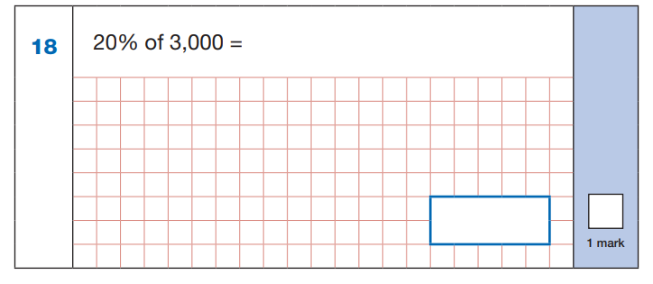
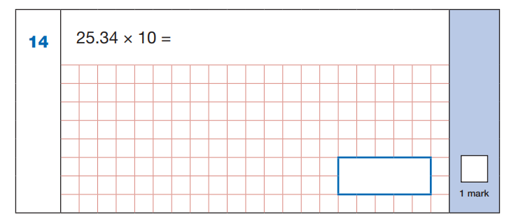
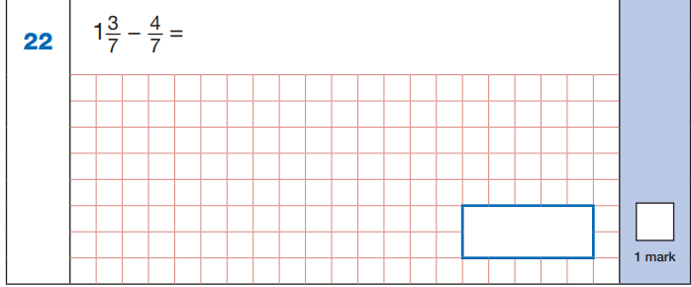
SATs Week
3 Maths tests – 1 Arithmetic and 2 reasoning papers

Slide 22
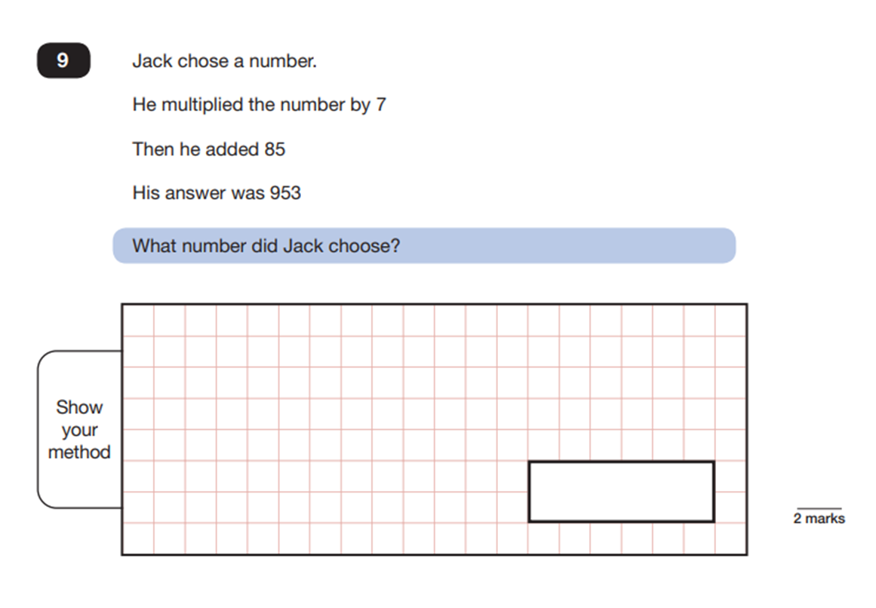
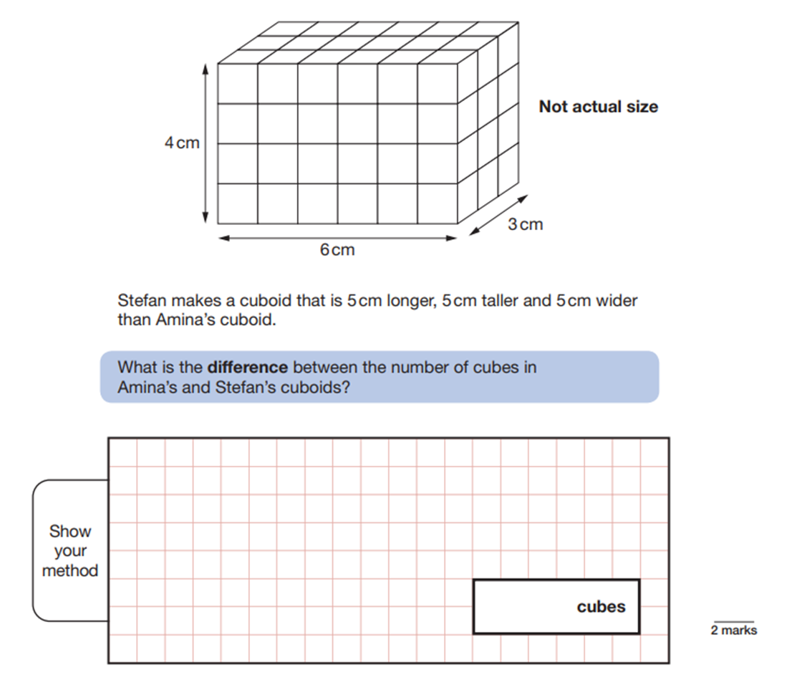

Slide 23
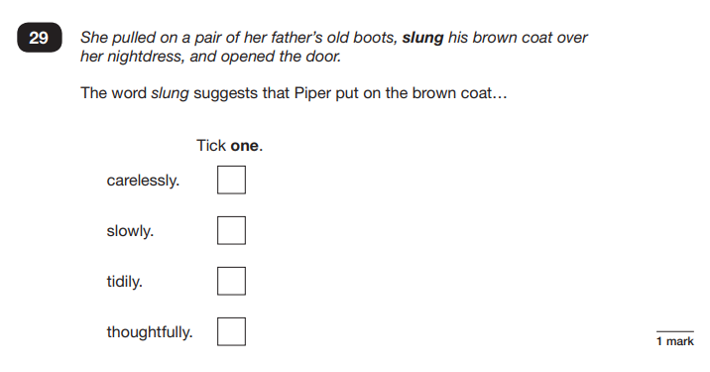
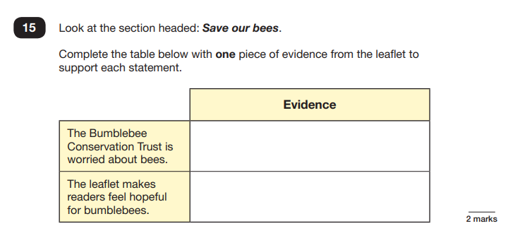
SATs Week
1 Reading paper
1 Spelling paper
1 Grammar paper

Slide 24
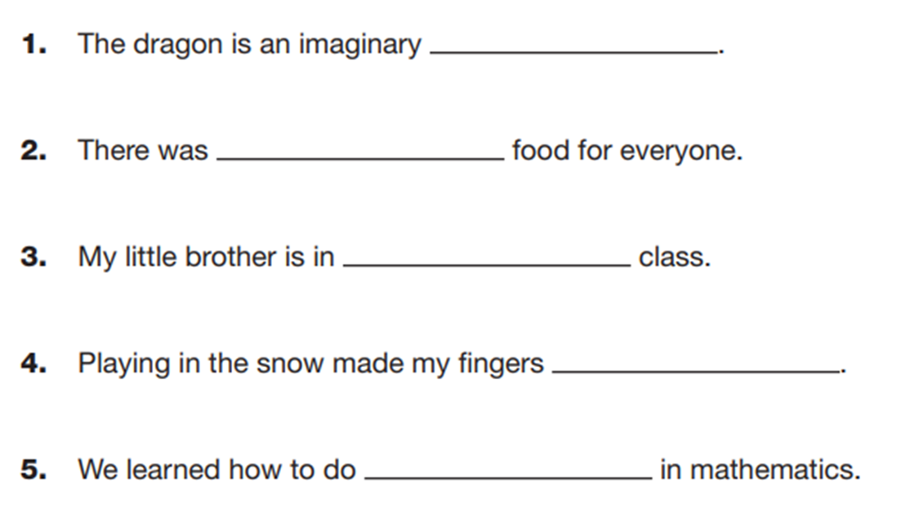

Slide 25
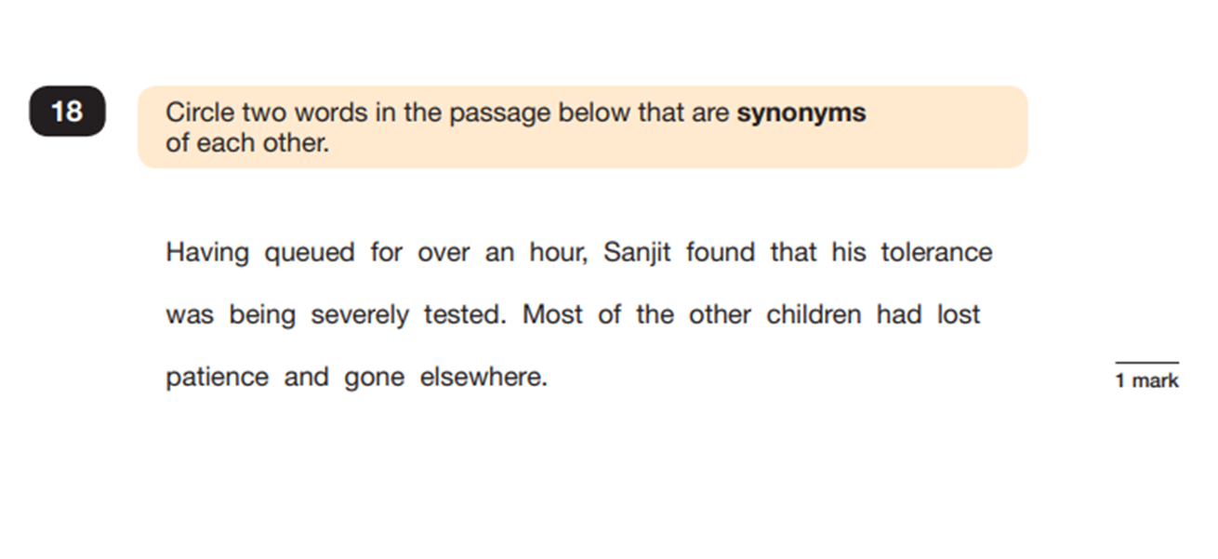
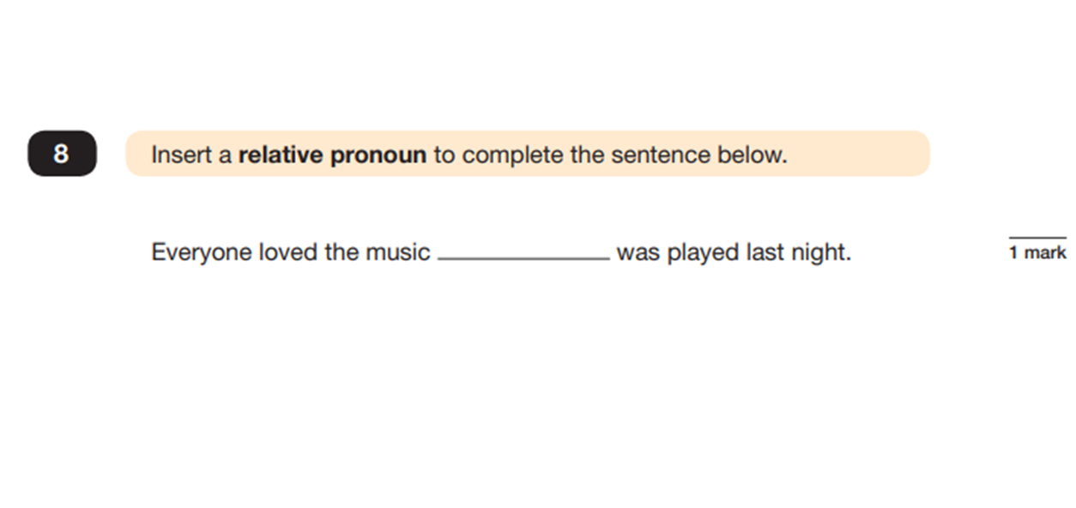

Slide 26
What can parents/carers do?
Reading- ORB
Mental Maths strategies/Times Table Rockstars
Reading
Doodle
Attendance
Reading
Feeding and sleeping routines make a big difference to school performance
Reading
Family visits to WW2 exhibits such as Duxford etc.

Slide 27
Links to help with learning
https://www.khanacademy.org/
www.educationcity.co.uk
www.bitesize.co.uk
www.oxfordreadingbuddy.com
https://ttrockstars.com/

Slide 28

Thank you for your time.
- If you have any further questions, please ask them via Class Dojo.

