Slide 1

Welcome Meeting- Year 3
2025- 2026

Slide 2
Meeting the Year 3 team
Mr Paul – Phase Leader
Miss Hoque
Morris Class
Ms Emin
Banksy Class
Ms Kaur
Hepworth Class

Slide 3
Chain of communication
Class Teacher → Phase Leader → Ms Kalhan → Mr Walker

Slide 4

Attendance / Lateness
Attendance is key to making good progress, so it’s important to ensure your child attends every day.
It is important that your child is at school on time as core subjects take place in the mornings.
New timings to school day :
8:50 – Gate opens
9:00 – Registration is taken
Lunch is 12:00-13:00
If they arrive at 9:05 or later, they will be recorded as late.
Please read the attendance policy for more details. This can be found on the school website.

Slide 5

Meal selection
If your child is school dinners, please pre-order lunches at home.
Even if they are school dinners, please make sure that they bring a labelled water bottle with them.
For this academic year, all primary school children will have their school meals paid for in London.

Slide 6
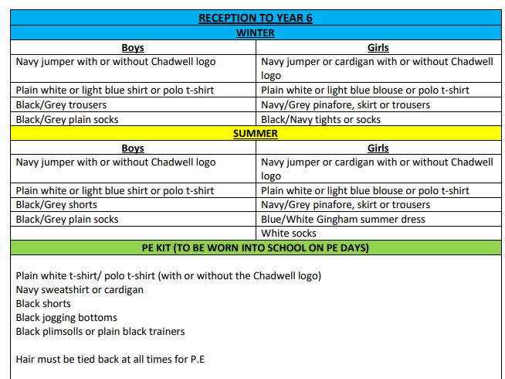
Uniform
This document can be found on our school website under the 'parents' tab.

Slide 7
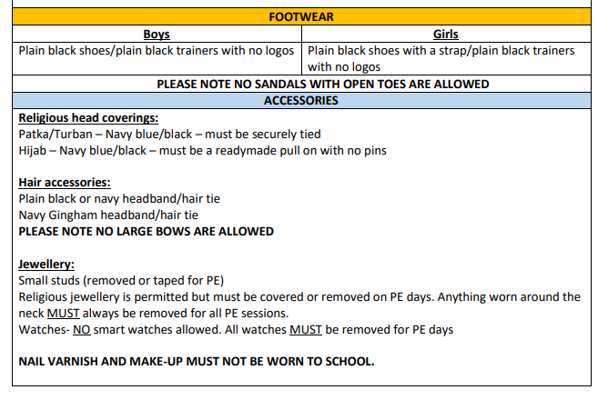
Uniform
This document can be found on our school website under the 'parents' tab.

Slide 8
P.E. Uniform
Black/Navy shorts
Plain white or blue T-shirt
Black plimsolls or trainers
Black or Navy track suit or jogging bottoms for outdoor games in cold weather
Pupils can also wear their school uniform jumper on top during colder weather

Slide 9






Writing
These books may be subject to change
English lessons are based on a core text.
Writing is taught both through discrete English lessons and through other areas of the curriculum.
The texts we will be focusing on this year are: Stone Age Boy, Fly Eagle Fly, Milo Imagines the world, Into the Forest, Marcy and the Riddle of the Sphinx, Escape from Pompeii.

Slide 10
Reading
We teach reading through:
Use of the Oxford Reading Tree scheme to teach Reading (de-coding, segmenting, blending and vocabulary) as well as reading skills (prediction, comprehension, features of books)
Free choice of books from class reading area
Free choice of books from school library
Guided Reading to teach specific types of reading skills
Reading and the teaching of books in English lessons – whole school
You could:
Visit your local library
Have story time before bed
Read regularly with your child

Slide 11

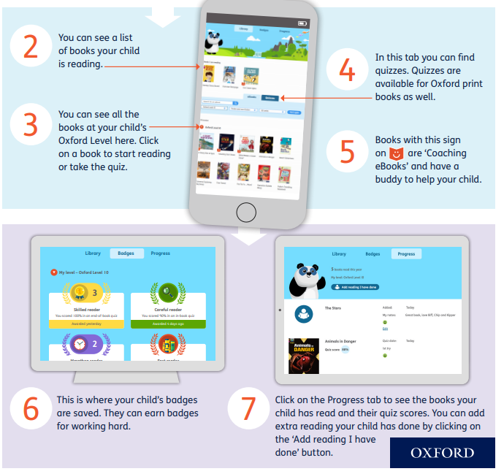
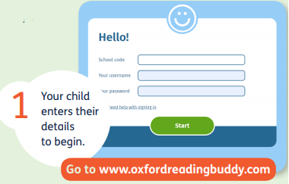
Reading – Oxford Reading Buddy
n1tts
Every child has a log on card.

Slide 12

Reading books
Children will change their books at least once a week.
Reading records will not be used.
Please read with your child as often as possible.
It is essential to talk through the book with your child and ask them questions to monitor their understanding and deepen their comprehension skills.

Slide 13


Maths – Maths Mastery
Mathematics Mastery by Ark Curriculum Plus is a carefully sequenced programme designed to help all pupils develop a deep, secure, and long-lasting understanding of mathematics. Built on the principles of mastery, the programme focuses on three key dimensions of learning: conceptual understanding, mathematical thinking, and language and communication. These principles are embedded throughout Key Stages 1 and 2 to ensure consistent progression and to support all learners in developing the knowledge and confidence they need to succeed in maths.
In Key Stage 2, the curriculum builds systematically on the foundations laid in earlier years, deepening pupils’ understanding of number, calculation, fractions, geometry, measurement, and statistics. Lessons follow a clear structure using the Concrete–Pictorial–Abstract (CPA) approach, allowing pupils to explore concepts using manipulatives and visual representations before moving to abstract methods. Regular opportunities for reasoning and problem-solving strengthen fluency while encouraging pupils to make connections and apply their knowledge in a range of contexts.
This approach ensures that pupils leave Key Stage 2 with a strong foundation for further mathematical study in upper Key Stage 2 and secondary school. By focusing on depth rather than acceleration, the programme closes gaps in understanding and promotes confidence, resilience, and flexibility in thinking. Pupils develop the ability to explain their reasoning, justify their methods, and solve increasingly complex problems—skills that are essential not just for maths, but for learning across the curriculum.

Slide 14

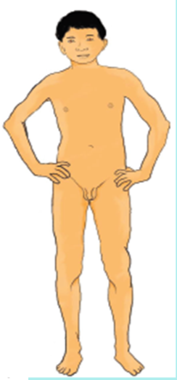
Relationship and Health Education (RHE)
These lessons are compulsory, and you will not be able to pull your child out.
As part of the National curriculum children will be learning about the scientific names of body parts from Year 3 onwards.
Scientific Names:
Penis
Vulva
Buttocks
Chest
These are the resource images that all classes in Year 3 and above will use;

Slide 15

Homework- Doodle for Learning
Homework for Years 3, 4, 5 and 6 will now be assigned on Doodle for learning. Doodle for learning is an online educational program for children, focusing on Maths, English, Timetables and Spelling.
Your child will complete a baseline assessment in class as he/she must needs to complete this independently, so that the app can get a clear understanding of their strengths and weaknesses and adapt to the individual needs. Doodle will then target any gaps your child’s understanding through their personalised work programme. This may mean covering work from previous year groups – ensuring a secure understanding which will then support their classroom learning.
Children are encouraged to use it for 10 minutes a day (where possible), so your child works through their personalised programmes really boosts their confidence and attainment!
More information regarding Doodle for these year groups, will be on ClassDojo and be give login slip to take home explaining how Parents/Carers can login and create a login account to see their child's progress.
Happy Doodling!

Slide 16

Birthdays
Please do not send in any food items to hand out to the class as this is strictly not allowed.
We are a healthy eating school and many children in our school have food allergies.

Slide 17

P.E. days
Please ensure that your child wears their P.E. kit to school, underneath their jumper.
Outdoor and Indoor P.E. slots:
Banksy and Hepworth-Tuesday/Wednesday
Morris – Monday/Wednesday.

Slide 18
Educational visits
Our first trip will be to Valance House which will be later this term and you will be updated with details via Class Dojo.
If you are able to take children out and about on any trips on the weekends and holidays that would be great as well.

Slide 19
Snacks
Children can bring a small snack in for the morning break.
This could include:
  Breadsticks
  Crackers
  Biscuits
  Fruit (no bananas permitted)
Please do NOT send in any chocolate, crisps, cake or food with nuts in.

Slide 20

Thank you for your time.
- If you have any further questions, please ask them via Class Dojo.

