Slide 1

Year 2 Welcome Meeting
2025 - 2026

Slide 2
Meeting the Year 2 team
Miss Patel– Phase Leader
Miss Kerr
Bell class
Miss Shah
Dyson class
Miss Patel
Jackson class
Chain of communication​
Class Teacher --> Phase Leader --> Senior Leadership​

Slide 3

Attendance / Lateness
Attendance is key to making good progress, so it’s really important to ensure your child attends everyday.
It is important that your child is at school on time as core subjects take place in the mornings.
Timings to school day : 8.50am -3.30pm
Gates close at 9am

Slide 4

Meal selection
If your child is school dinners, please pre-order lunches at home.
  Children will be given a jacket potato if an order has not been made.
Even if they are school dinners, please make sure that they bring a labelled water bottle with them.

Slide 5
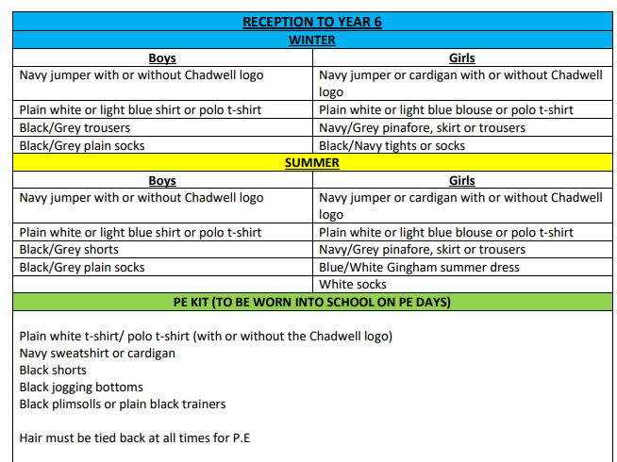
Uniform
This document can be found on our school website under the 'parents' tab.

Slide 6
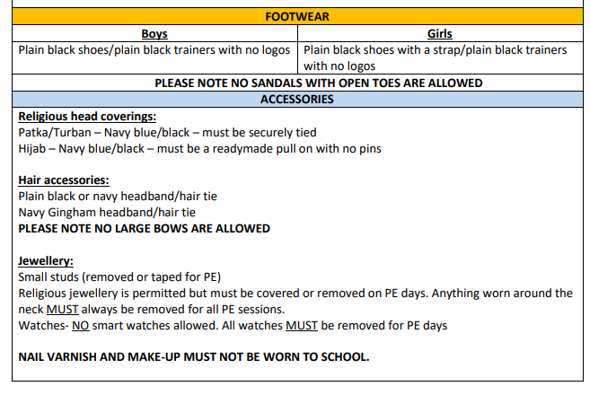
Uniform
This document can be found on our school website under the 'parents' tab.

Slide 7
P.E. Uniform
Black/Navy shorts
Plain white or blue T-shirt
Black plimsolls or trainers
Black or Navy track suit or jogging bottoms for outdoor games in cold weather
Pupils can also wear their school uniform jumper on top during colder weather

Slide 8

P.E. days
Please ensure that your child wears their P.E. kit to school, underneath their jumper.
Dyson: Thursday and Wednesday
Bell class: Thursday and Monday
Jackson: Thursday and Friday

Slide 9






English
English lessons are based on a core text.
Writing is taught both through discrete English lessons and through other areas of the curriculum.
The texts we will be focusing on this year are:
Look Up!, The Owl who was Afraid of the Dark, The Dragon Machine, My Name is not Refugee, Tidy, The Tempest

Slide 10
Reading
We teach reading through:
Use of the Oxford Reading Tree scheme to teach Reading (de-coding, segmenting, blending and vocabulary) as well as reading skills (prediction, comprehension, features of books)
Free choice of books from class reading area
Free choice of books from school library
Guided Reading to teach specific types of reading skills
Reading and the teaching of books in English lessons – whole school
You could:
Visit your local library
Have story time before bed
Read regularly with your child
There is a charge for any lost/damaged books depending on the value

Slide 11

Reading books
Children will change their books at least once a week.
Please ensure children read their book more than once.
Please read with your child as often as possible.
It is essential to talk through the book with your child and ask them questions to monitor their understanding and deepen their comprehension skills.
Reading stage books are expected to be in school every day and taken home every day. Children will need to bring in book bags to carry their books to avoid them getting damaged/lost.

Slide 12


Maths – Maths Mastery
Mathematics Mastery by Ark Curriculum Plus is an evidence-based programme designed to help all pupils develop a deep understanding of mathematics. Rooted in the mastery approach, it emphasises depth over speed, encouraging pupils to fully grasp key concepts before moving on. The curriculum is carefully sequenced and built around three key dimensions: conceptual understanding, mathematical thinking, and language and communication. These principles are consistently applied from Reception through to Key Stage 2, ensuring continuity and coherence across year groups.
In Key Stage 1, the programme introduces core mathematical ideas through the Concrete–Pictorial–Abstract (CPA) approach. Pupils explore numbers, shape, space, and measure using physical objects, visual representations, and eventually symbols. Through structured activities, pupils are supported to develop early reasoning, pattern spotting, and vocabulary development. The consistent use of representations and structured progression ensures that pupils are well-prepared for the more complex and abstract concepts introduced in Key Stage 2. By developing fluency, reasoning, and problem-solving skills from an early stage, the programme equips pupils with the tools they need to succeed in upper primary and beyond.

Slide 13

Relationship and Health Education (RHE)
These lessons are compulsory and you will not be able to pull your child out
As part of the National Curriculum children will be learning about the scientific names of body parts from Year 3 onwards.
In Year 2, children will be taught the term private parts in conjunction with the NSPCC PANTS rule.

Slide 14

Homework
Homework will be set via Class Dojo.
The children will need to access:
  Oxford Reading Buddy
Homework will be set on Thursday and needs to be completed by the following Wednesday
Homework must be completed as it consolidates what the children have been learning in class.
Please ensure you help your child and check that they have completed their homework.

Slide 15
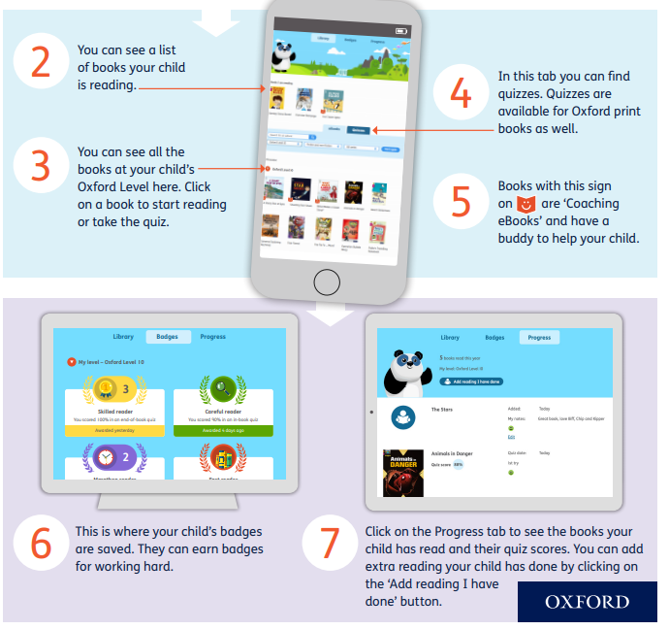

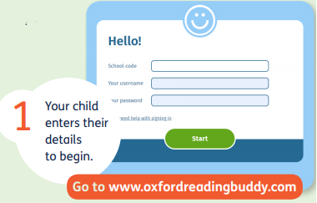
Reading – Oxford Reading Buddy
n1tts
Every child has a log on card.

Slide 16

Maths -Numbots
NumBots is a fun, engaging, online maths learning platform designed for young children to build foundational skills in number recognition, number bonds, and mental addition and subtraction. It uses a game-based approach, often featuring a character named Rusty, to motivate children to achieve "understanding, recall and fluency".
Children progress through stages by answering questions accurately and timely, earning stars to unlock new levels. Parents can support their child's progress by encouraging "little and often" practice (e.g., a few minutes daily).

Slide 17

Birthdays
Please do not send in any food items to hand out to the class as this is strictly not allowed.
We are a healthy eating school and many children in our school have food allergies.

Slide 18

Educational visits
Stay tuned...
Later in the year, we are aiming to go to the Tower of London. We will need parent volunteers.
If you would like to volunteer to accompany us on any trips, please send a message to your child's class teacher, via Class Dojo.

Slide 19
Snacks
The school provides a piece of fruit for each child
This could include:
  Apples
  Tomatoes
  Pears
  Oranges
  Snap peas
  Raisins

Slide 20

If you have any further questions, please ask them via Class Dojo.

