Slide 1

Parent Expectations Meeting- Reception
2025- 2026

Slide 2
Meet the Reception team
Mrs Dhanda– EYFS Phase Leader
Mrs Dhanda/Mrs Vas
Donaldson class
Mrs Tomlinson
Carle class
Miss Buendia
Andreae class

Slide 3
Chain of communication
Class Teacher → Phase Leader → Senior Leadership

Slide 4

Attendance / Lateness
Attendance is key to making good progress, so it’s really important to ensure your child attends every day.
It is important that your child is at school on time as core subjects take place in the mornings.
School Timings:
8:50 – Gate opens
9:00 – Gates close
Lunch is 11:30- 12:30
Please read the attendance policy for more details on late marks and absence percentages. This can be found on the school website

Slide 5

Meal selection
If your child is school dinners, please pre-order lunches at home before 9am.
Even if they are school dinners, please make sure that they bring a labelled water bottle with them.
Any issues with school lunches will need to be discussed with the school office or emailed directly to The Pantry as they are a separate entity to the school.

Slide 6
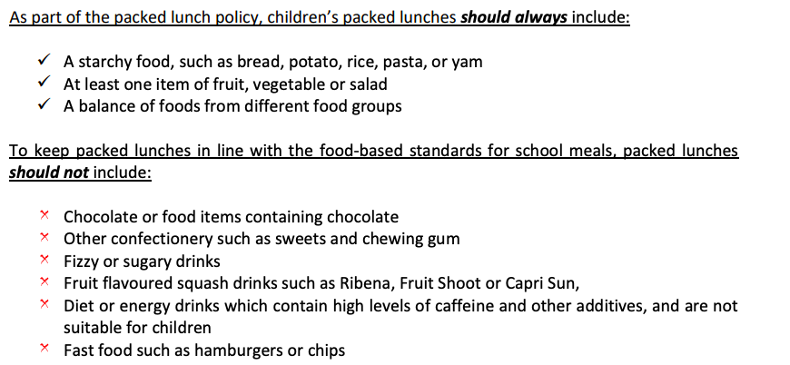
Packed Lunch Policy
Our packed lunch policy can be found on the school website.
Grapes and tomatoes should be cut in half lengthways to avoid choking

Slide 7
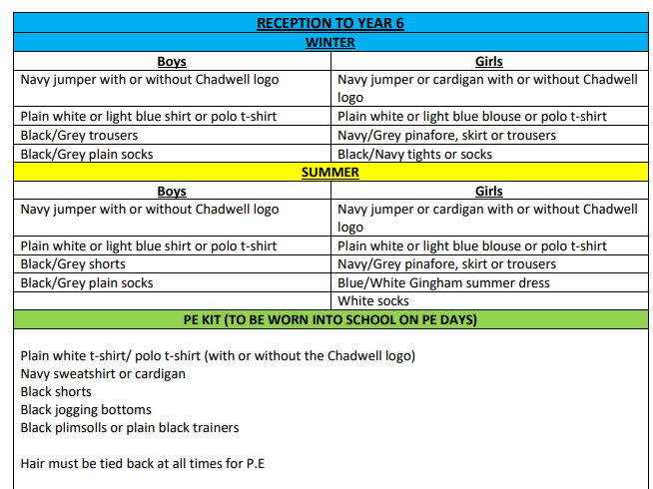
Uniform
This document can be found on our school website under the 'parents' tab.

Slide 8
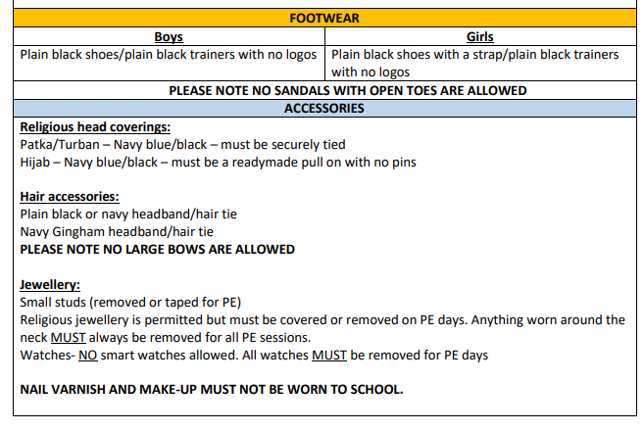
Uniform
This document can be found on our school website under the 'parents' tab.

Slide 9
P.E. Uniform
Black/Navy shorts
Plain white or blue T-shirt
Black plimsolls or trainers
Black or Navy track suit or jogging bottoms for outdoor games in cold weather
Pupils can also wear their school uniform jumper on top during colder weather
Jewellery will be taped up for P.E to prevent injury, ideally it would best if pupils do not wear earrings to school on P.E days

Slide 10

Birthdays
Please do not send in any food items to hand out to the class as this is strictly not allowed.
We are a healthy eating school and many children in our school have food allergies.

Slide 11

Class Dojo
All correspondence regarding your child's class will be shared on Class Dojo. If you have questions or need to discuss something with your child's class teacher please send them a message on Class Dojo
Please ensure you are checking for updates regularly, it is possible to download the app and set up notifications so that you are up to date.
You will also receive an alert if you child is rewarded a Dojo point during the school day, the children will receive these for displaying our Dispositions of Learning and the Golden Rules.

Slide 12
The EYFS Curriculum
The EYFS Curriculum is split into the following 7 areas:
Prime Areas:
Communication and Language
Personal, Social and Emotional Development
Physical Development
Specific Areas:
Literacy
Mathematics
Expressive Arts and Design
Understanding the World
At the end of the year, we will assess pupils against the Early Learning Goals (ELGs) in all 7 areas.

Slide 13
Assessment in the Early Years
The children will be assessed against the Early Learning Goals across all areas in the curriculum.
At the end of the year they will achieve a Good Level of Development (GLD) by meeting the ELGs in 5 out of 7 areas (All the prime areas + Literacy and Maths)
Communication and Language is a key area as it impacts the ability to achieve ELGs in other areas of the curriculum.
E.g 'Talk about members of their immediate family'.

Slide 14
Reading
We teach reading through:
ELS Phonics Scheme
Use of the Oxford Reading Tree scheme to teach Reading (de-coding, segmenting, blending and vocabulary) as well as reading skills (prediction, comprehension, features of books)
Free choice of books from class reading area
Free choice of books from school library
Reading as a class during daily story time
You could:
Visit your local library
Have story time before bed
Read regularly with your child

Slide 15

Reading books
Once the children begin phonics lessons, they will bring home a book linking to the phonemes we are learning that week. Your child should be able to read the book with little support by segmenting and blending the words.
Please read with your child as often as possible and send their reading folder in every day.
It is essential to talk through the book with your child and ask them questions to check their understanding.

Slide 16


Maths – Mathematics Mastery
Mathematics Mastery by Ark Curriculum Plus provides reception children with a strong and well-structured foundation in maths, built around a carefully sequenced, evidence-based curriculum. It uses the Concrete–Pictorial–Abstract (CPA) approach, encouraging children to explore mathematical concepts using real objects, visual representations, and gradually move to abstract symbols. This method, combined with built-in assessment, ensures children develop a secure understanding of early number, shape, space, and measure in a way that is meaningful and engaging.
The programme focuses on three key areas: conceptual understanding, mathematical thinking, and language and communication. Children are encouraged to talk about their maths, explain their thinking, and explore patterns and relationships. These skills support deeper learning and reasoning, which are essential as they move into Year 1 and Year 2. By embedding mathematical language early on and encouraging structured thinking, the programme helps children become confident learners who can articulate their ideas and solve problems effectively.
This early mastery approach prepares children for the Key Stage 1 curriculum by promoting depth over speed and ensuring that core concepts are deeply understood. Pupils entering Year 1 are already familiar with key representations, routines, and vocabulary, enabling a smooth transition into more formal learning. Over time, this strong foundation leads to improved progress and greater confidence.

Slide 17

Homework
Homework will be set on Class Dojo every Thursday.
Some weeks they may be asked to bring something in or practice a particular skill.
Every week they will be expected to revise the sounds they have learnt in phonics that week and practice their letter formation in their Homework book.
Homework must be completed as it consolidates what they have been learning in class or provides a learning opportunity for an upcoming topic.
Please ensure you help your child and check that they have completed their homework.

Slide 18

P.E. days
Please ensure that your child wears their P.E. kit to school, underneath their jumper.
P.E. slots (Starting after the half term holidays):
Carle Class: Thursday
Donaldson Class: Friday
Andreae Class: Wednesday

Slide 19
What to bring to school?
Water bottle with child's name labelled
Your child's reading book folder.
Children do not need to bring in bags or rucksacks
A coat/jacket- Children will access the outdoor learning area throughout the whole year. Nothing too special as it is likely to get wet, messy, sandy during outdoor learning.
A labelled set of spare uniform to be kept in school
Please make sure all items, including uniform, are labelled with your child's name. It saves a lot of confusion in class and encourages children to take responsibility for their belongings.

Slide 20
Supporting your child at home
Dressing themselves- putting on and zipping up their coat
Using toilet independently and asking to go
Tidying up after themselves
Holding a pencil
Counting to 20
Following simple instructions
Learning to write their name
Have conversations!
Singing nursery rhymes

Slide 21
Thank you for your time.
- If you have any further questions, please ask them via Class Dojo.

